Slide 1
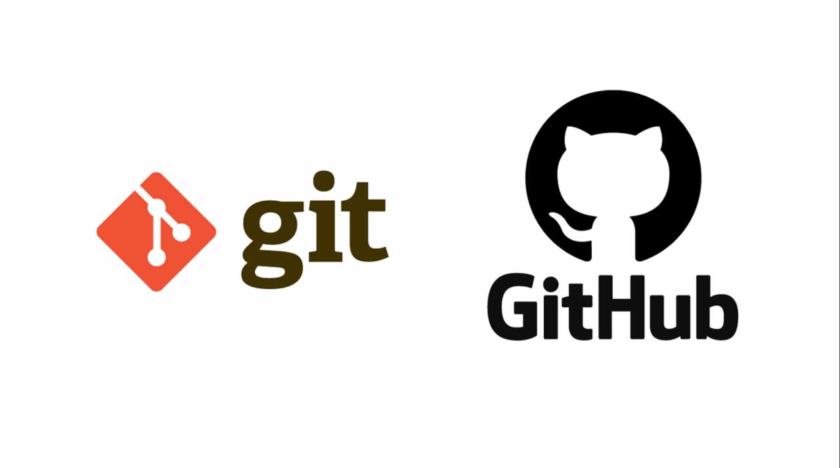

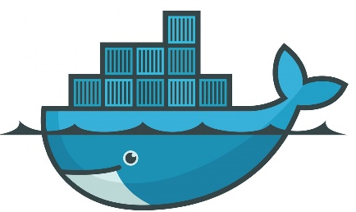

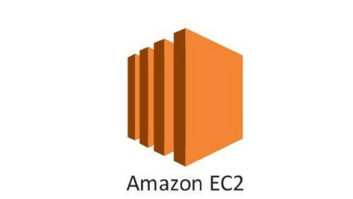


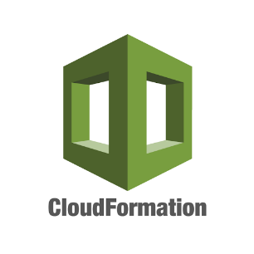



CI/CD Microservice Wep Application K8S-DockerSwarm-Rancher

Slide 2
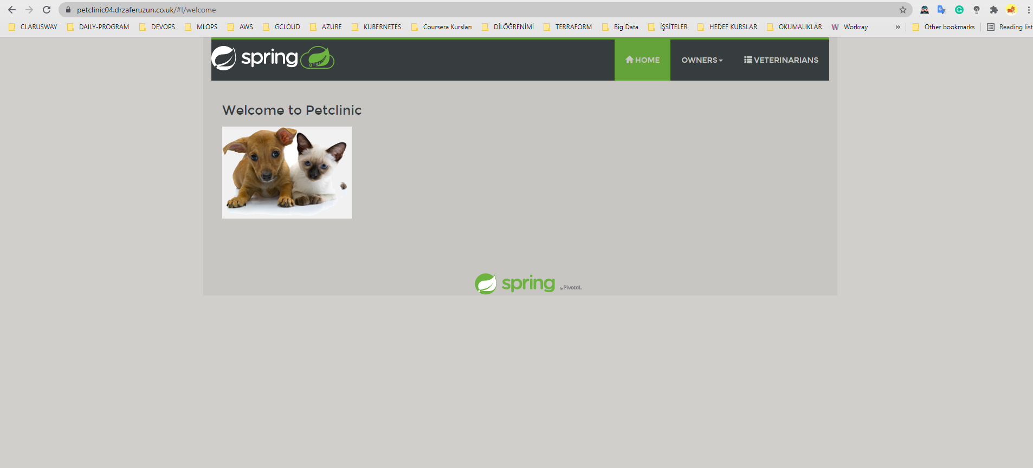
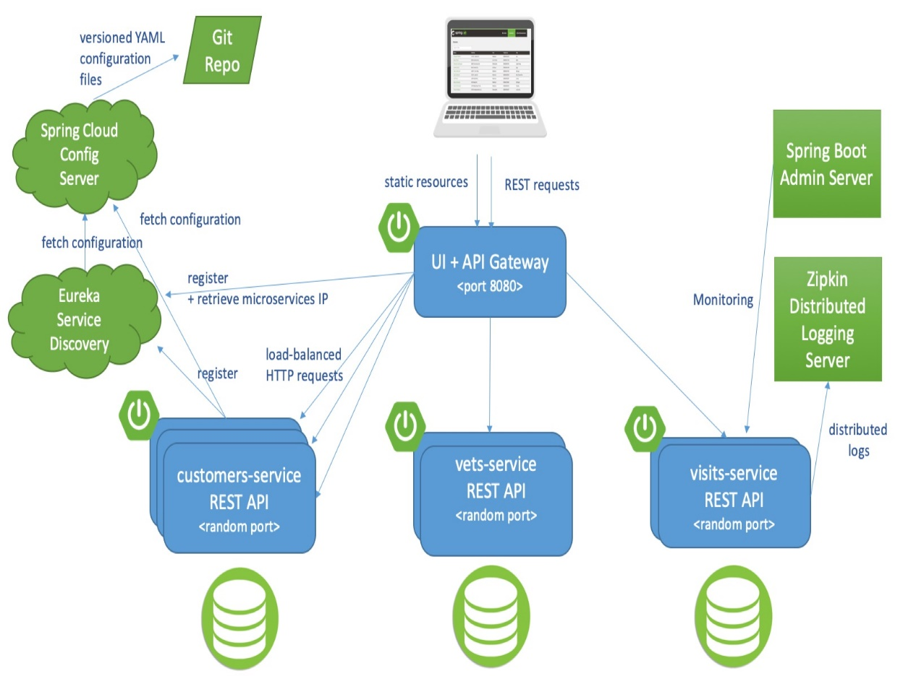
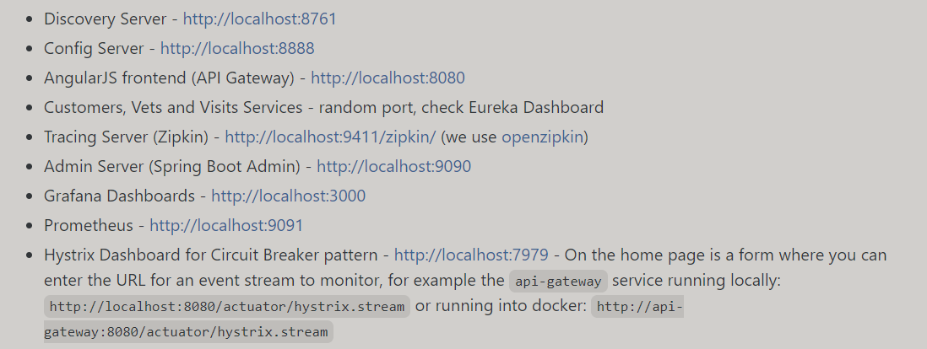
Notes:
This project is a Java-based petclinic-microservis web application developed by Spring company. The frontend part of the application was written in React and the backend part was written in Java.
The application has 3 main menus: Home, owners and veterenians.
The project consists of 8 microservices and there is also a monitoring service with Prometheus and Grafana. These services are:
Admin-server
Api-gateway(UI api-gateway)
Custom­er-server
Cofig-server
Discovery-server
Hystrix Dashboard
Vet Server
Visit Service
It is a cloud native application using Fly database.
Discovery-server: Ilk once calistiginda config-serverdan configurasyonlari aliyor ve calismaya basliyor. DNSservisi gibi load balancer yaparak microservislere yonlendiriyor. Servisler config serviceden configurasyonlarini aldiktan sonra euroka service e geliyorler ve registery yapiyorlar ben bu servisim diye. Ben bu servisim ben calisiyorum diye ve euroka bunlari listeden bakiyor registry yapiyor.
Vets-service application: Bu gercek bir microservis. Kendi pom.file i var. Bu servisin sadece get metodu var.
admin-server: Sistem properties, system details, metrics,configuration properties gibi tumverilerimicroservislerden toplar ve ui e iletir orada.

Slide 3
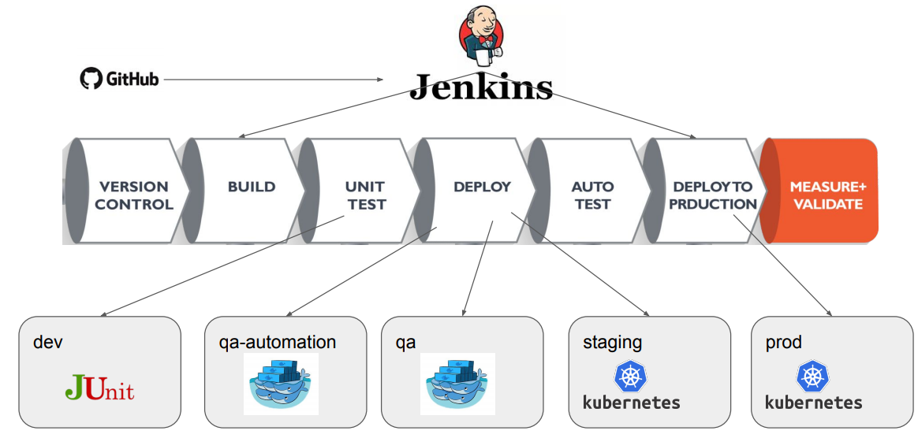

Slide 4
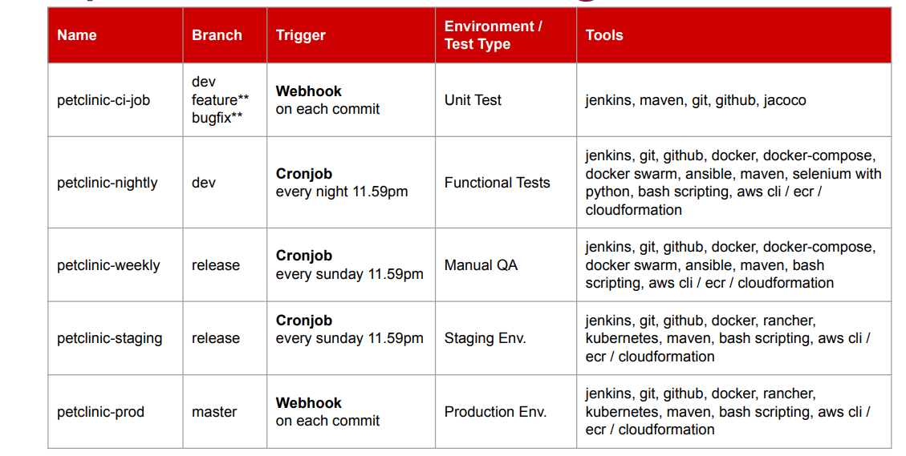
1
2
3
4
5
Notes:
I created 5 pipelines for this purpose: 1. Pipeline-ci-job: To trigger the webhook for dev, feature and bugfix branches; Pipeline was created to run build , Jacoco and unit tests.
Tools: Jenkins, maven, git, github, groovy, jacoco.
2. Pipeline-nightly: A pipeline was created with nightly-cronjob to perform build, unit test, deploy and functional tests in the environment deployed on docker-swarm to perform functional tests for the dev branch.
Tools: Jenkins, maven, git,github, docker, docker-compose, docker swarm, ansible, slenium with python, bash scripting, groovy, AWS cli, ecr, CloudFormation
3. Pipeline-weekly: In the release branch, a weekly pipeline was created for build, unit test, deploy operations. An environment was created for performing the manual tests.
Tools: Jenkins, maven, git, github, docker,docker-compose, docker swarm, ansible, bash scripting, groovy, AWS cli, ECR, CloudFormation
4. Pipeline-staging: For the staging environment in the release branch, I created a weekly pipeline for build, unit test, functional tests. In addition, manual tests were also performed in this environment. It's about what to do with post-pipeline code. The alpha, beta process can be gone, and it can be presented to the customer to perform user acceptance tests.
Tools: Jenkins, maven, git, github, docker, docker-compose, docker swarm, ansible, bash scripting, groovy, AWS cli, ECR , CloudFormation
5. Pipeline-prod: For the production environment in the master branch, I created a pipeline where build, unit test, deploy and functional test stages are realized by triggering the webhook.
Tools: Jenkins, maven, git, github, docker, docker-compose, docker swarm, ansible, bash scripting, groovy, AWS cli, ECR , CloudFormation
CI-job, nighty ve weekly pipeline lar docker swarm ile orchestrate edilmis iken staging ve prod pipeline lari ise kubernetes ile orchestrate edildi.

Slide 5
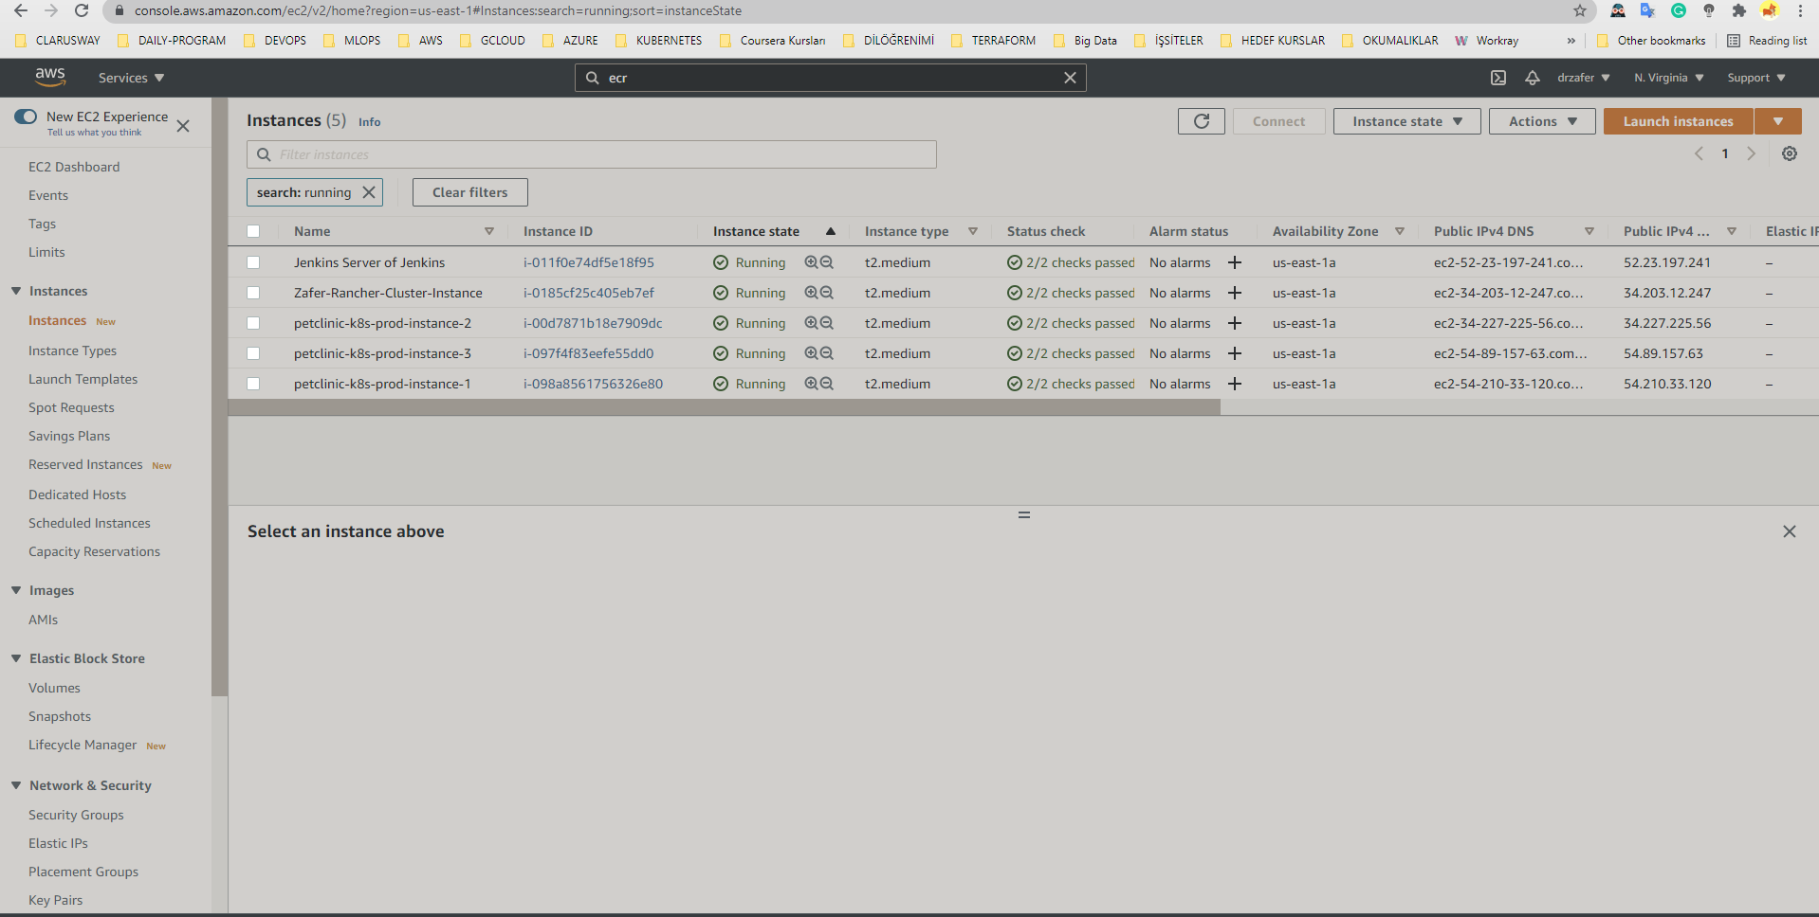

Slide 6
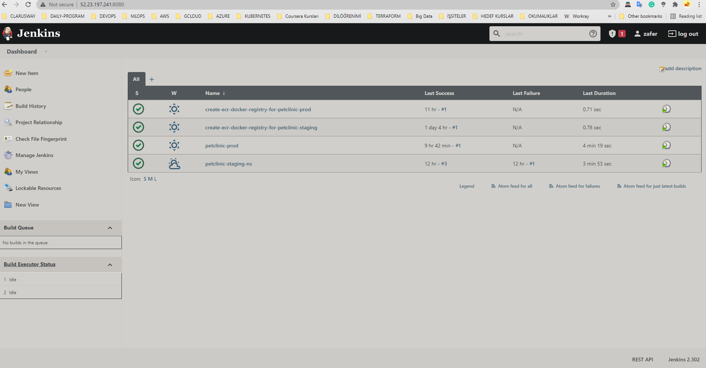

Slide 7
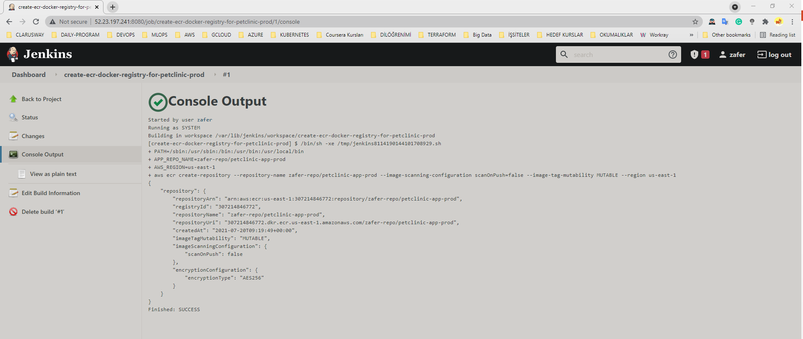

Slide 8
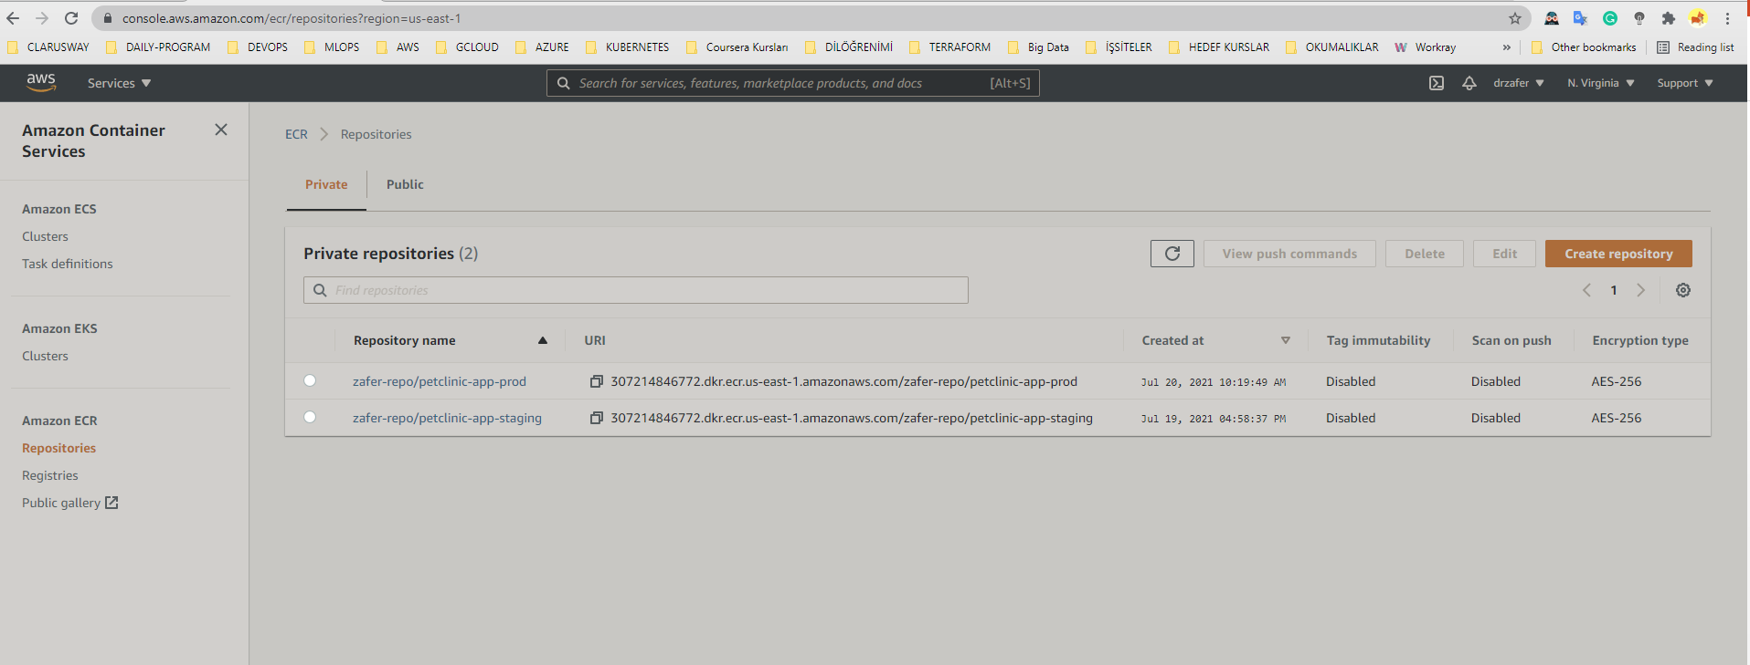
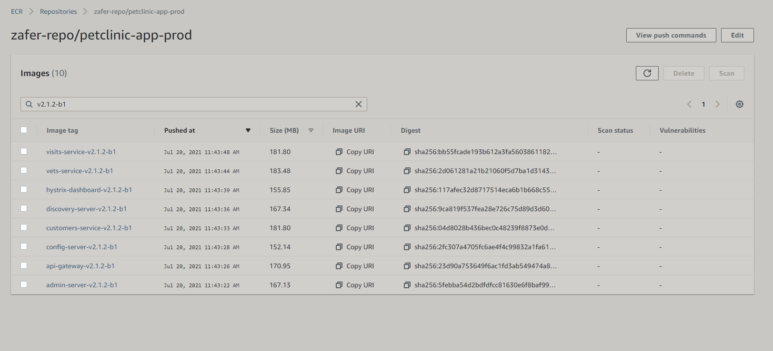

Slide 9
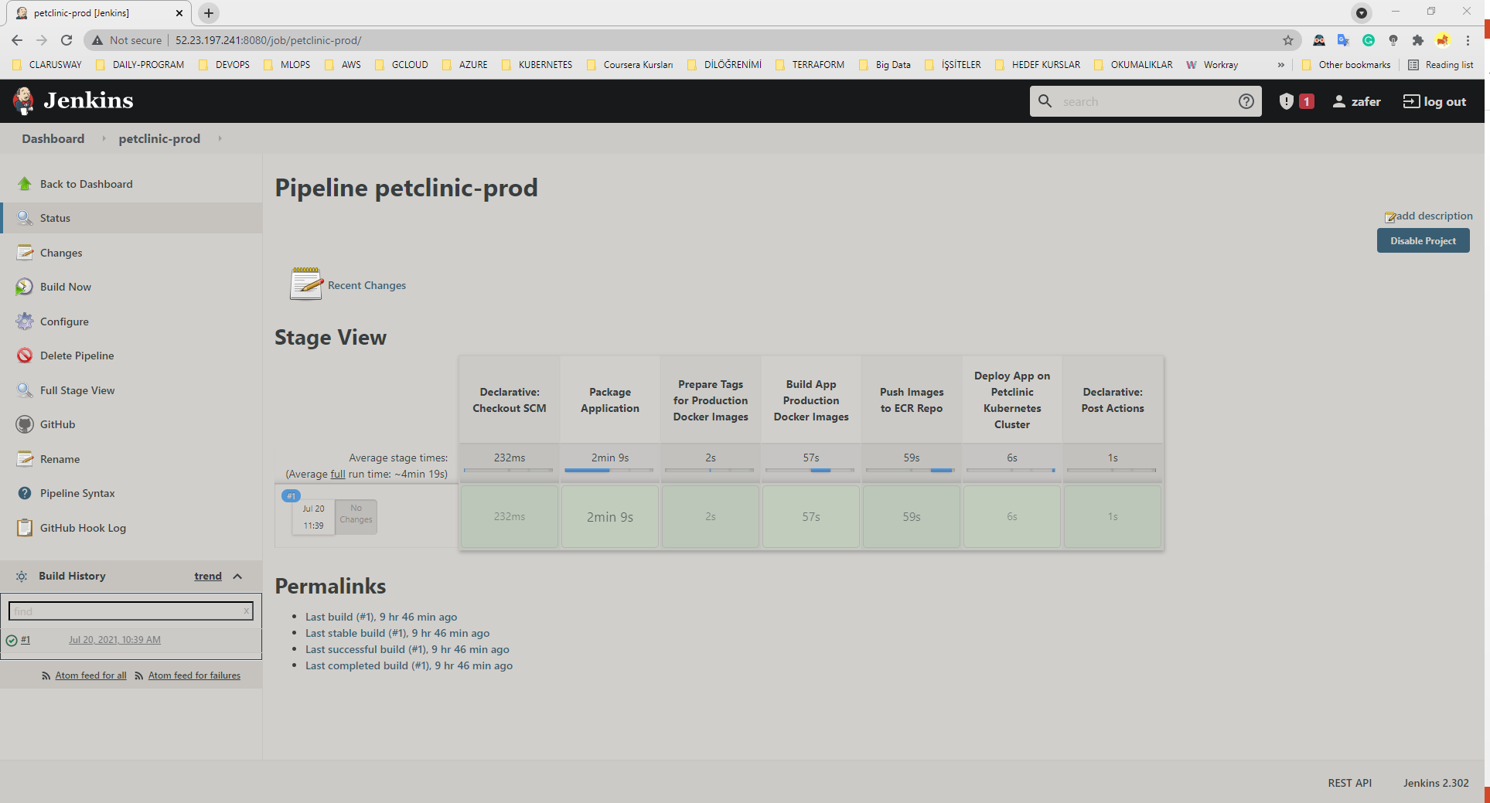

Slide 10
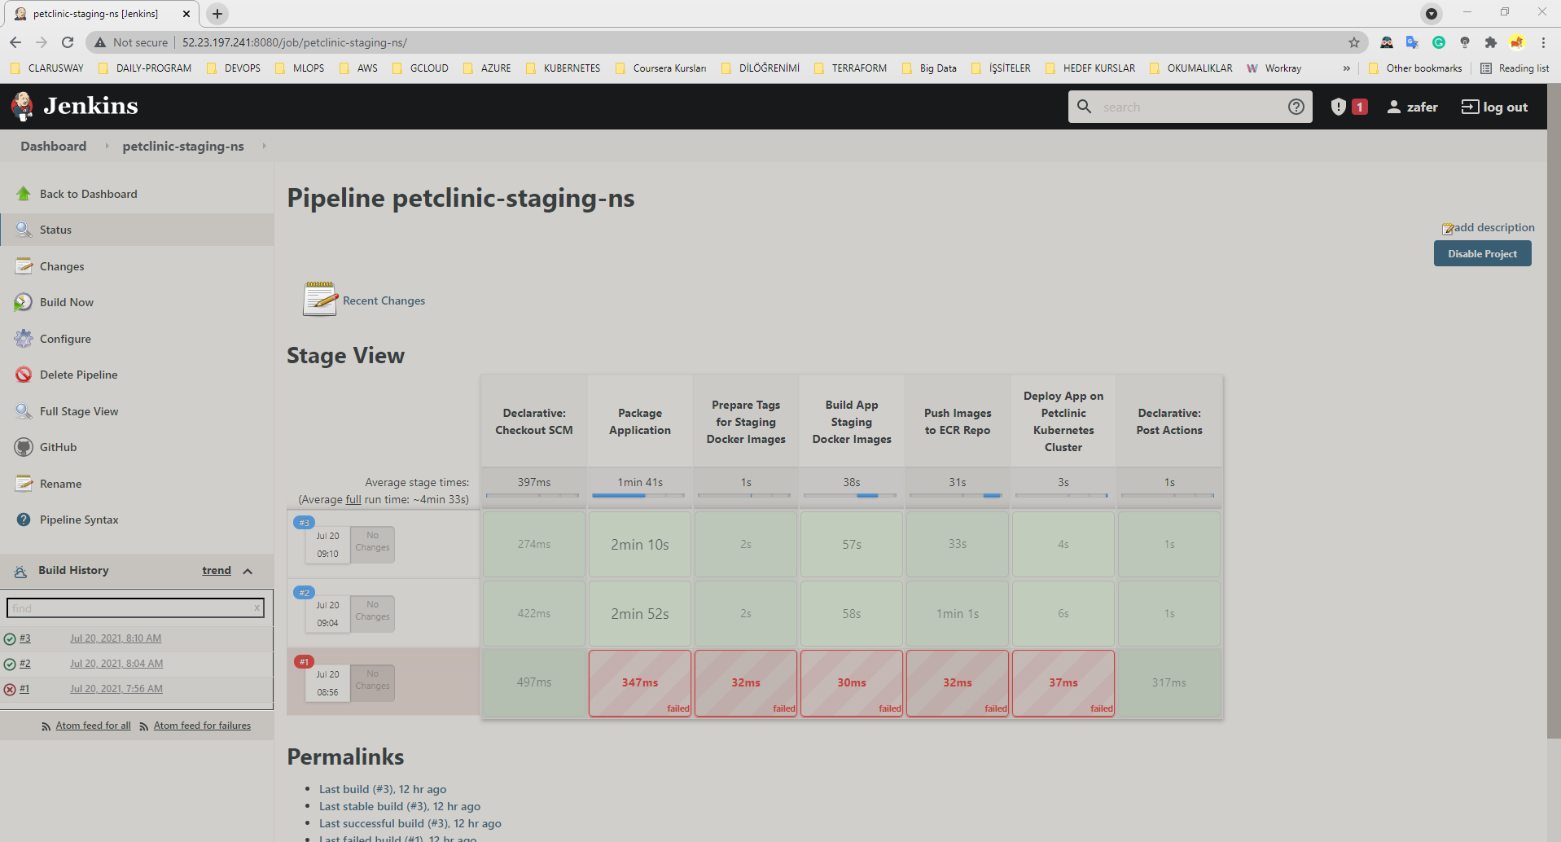

Slide 11
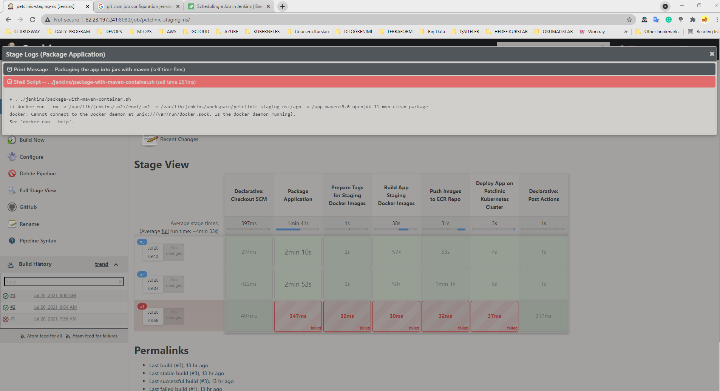

Slide 12
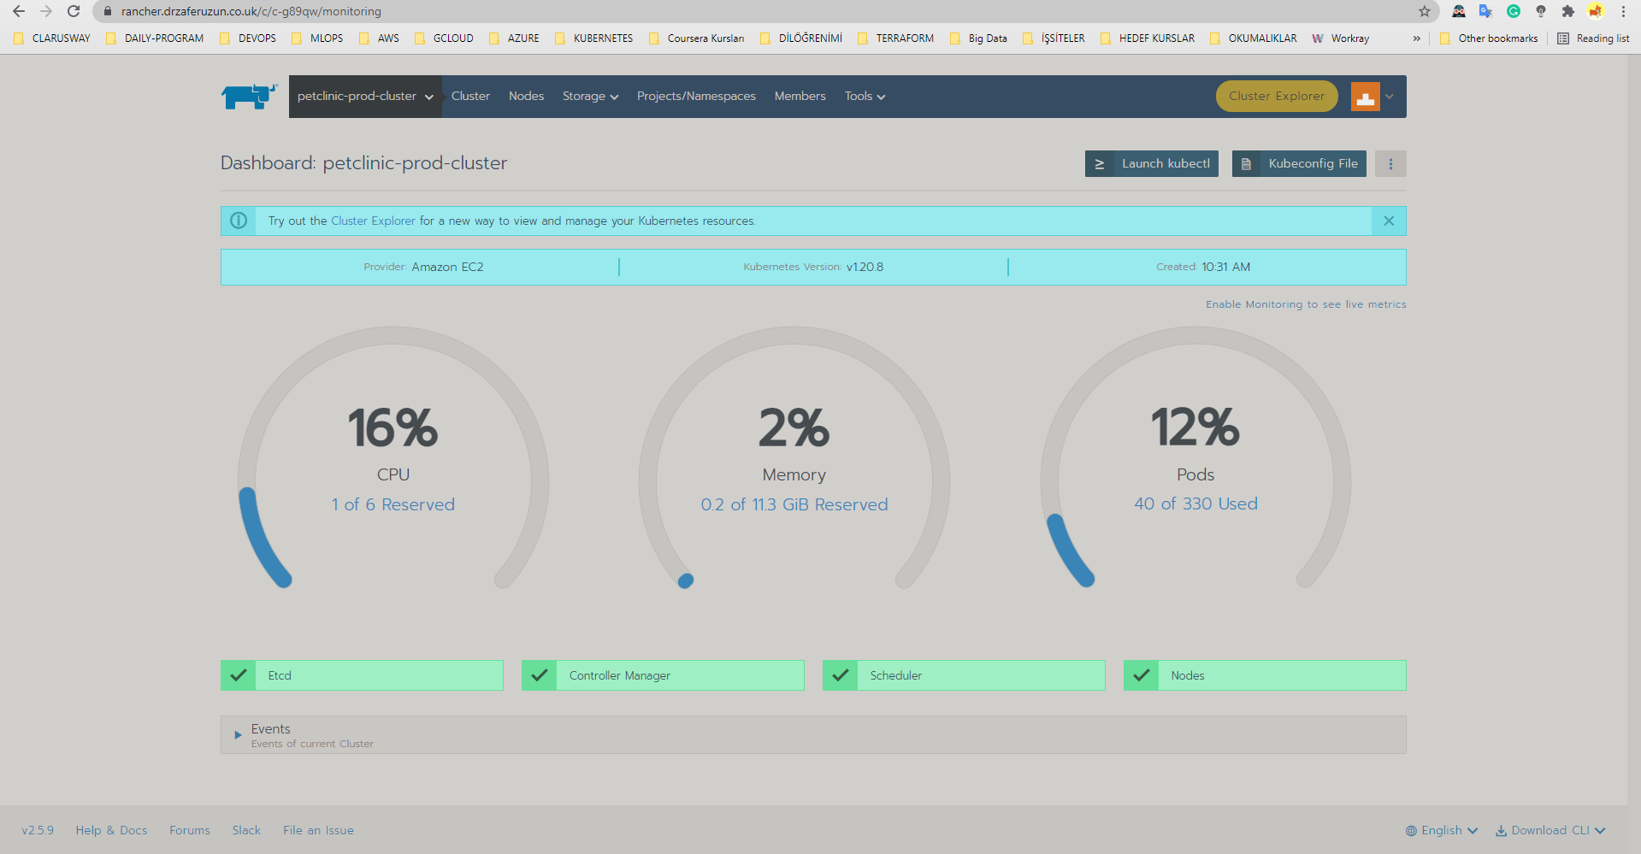

Slide 13
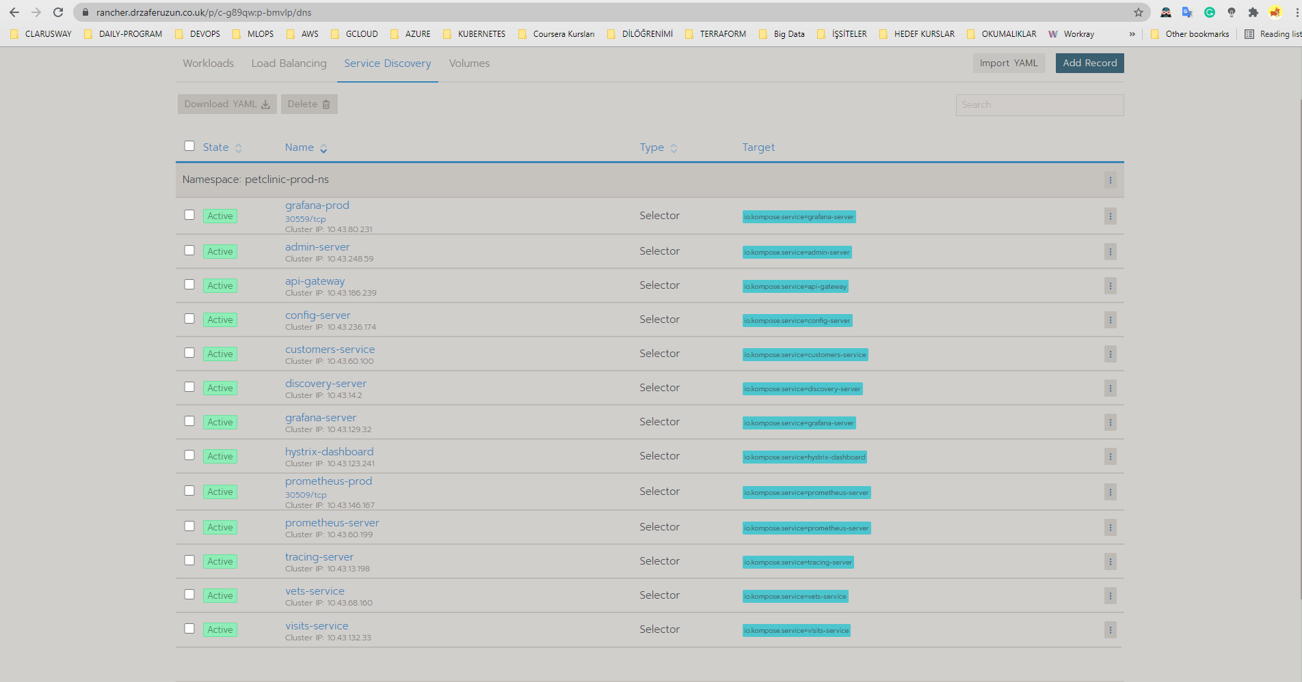

Slide 14
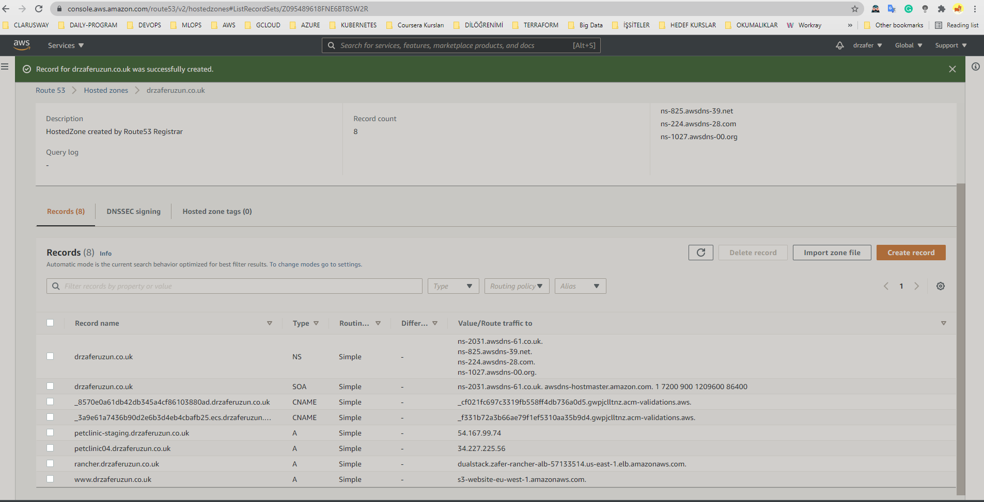

Slide 15
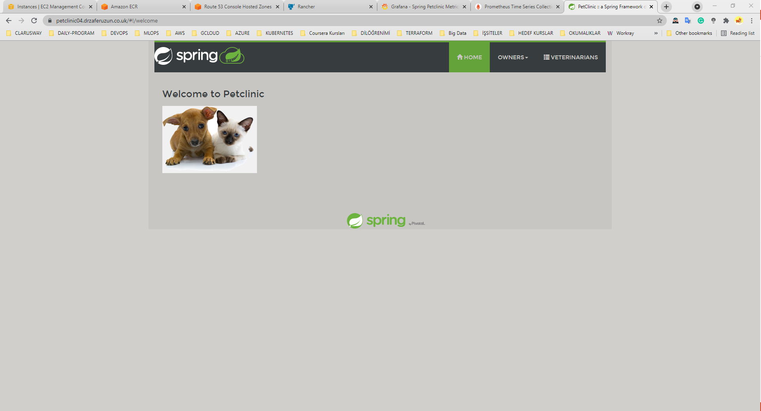
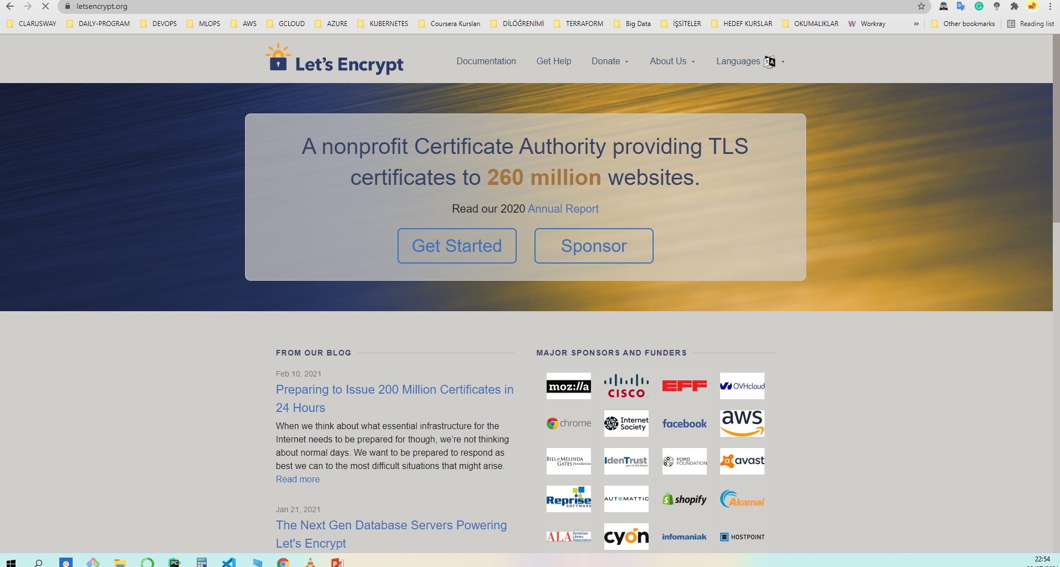
Happy Dogs And Cats in a Secure Cluster☺

Slide 16
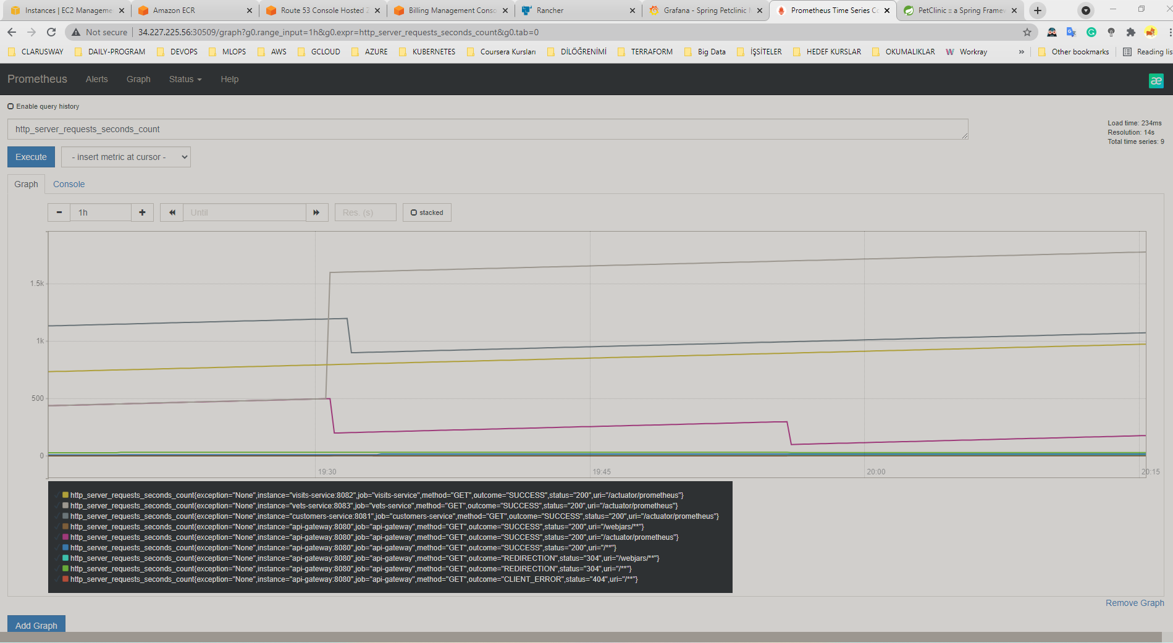
Notes:
Grafana and Prometheus are included in the docker-compose.yml configuration, and the public facing applications have been instrumented with MicroMeter to collect JVM and custom business metrics.

Slide 17
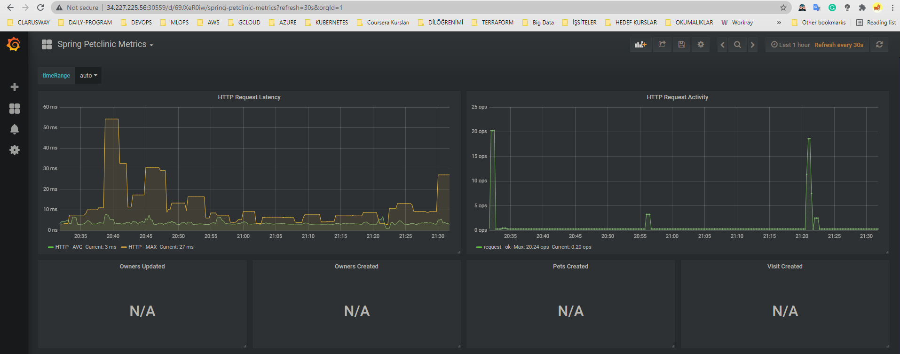

Slide 18
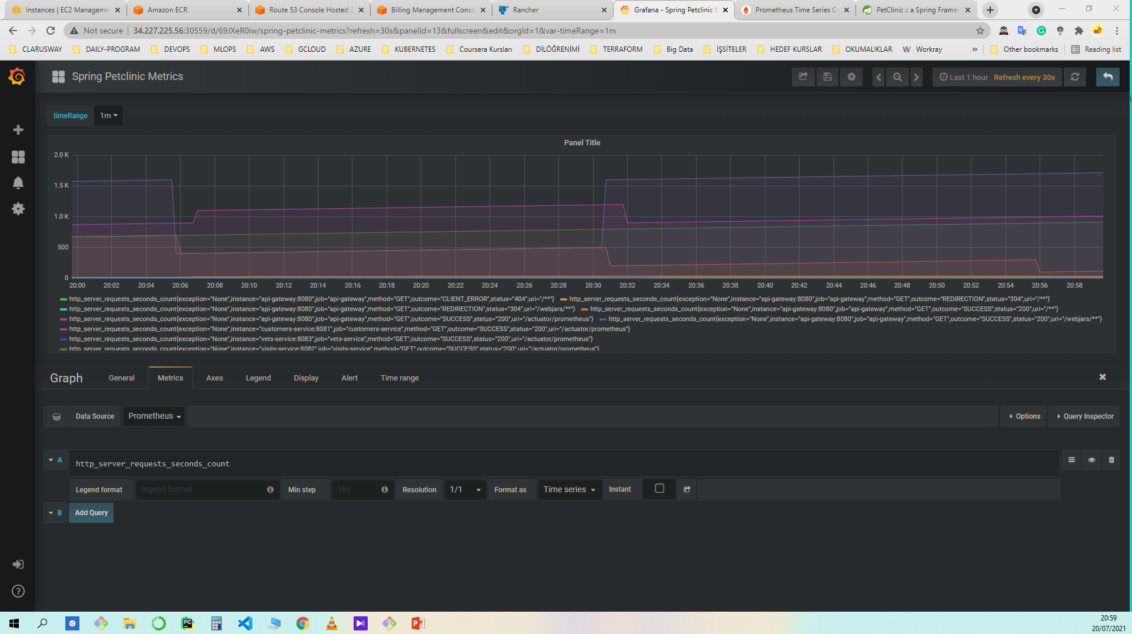

Slide 19
